Slide 1

Risk Management Plan and Quality Management
Team 5: Vanilla Systems
Presenter: Thushal Venkatesh IT-493-DL1
Date: 3/3/2023

Slide 2
Quality Management
Quality management in IT refers to ensuring that the process and services are reliable and satisfy the client needs. This would mean preventing errors and product defects from occurring and making sure they are up to par with the stakeholder requirements (Project). Some examples of this is:
Setting up a quality scale or standard
Testing
Improving

Slide 3
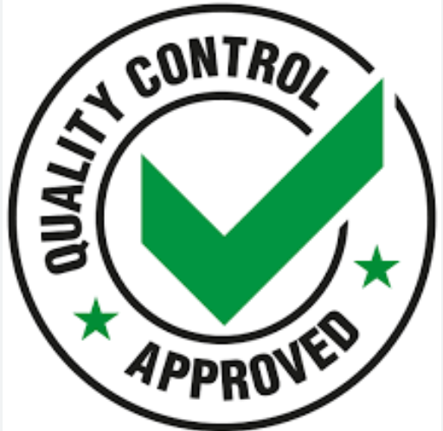
Quality Control
Quality control is measures taken to test units to determine if they meet the standards set for the final product (Hayes).
Notes:
According to Investopedia quality control is…

Slide 4
Quality Assurance
Quality assurance is making sure that products and services are made to meet the quality standards set before hand and also meet customer requirements (Project). Examples of this include:
Setting quality standards
Customer ratings and reviews via survey
Inspections

Slide 5
Quality Management on our project
As said earlier the purpose of quality management is to make sure client needs and standards are met or exceeded. This is very important for our project because we are showcasing the quality of our services and product to our client and his reviews will reflect the reputation of our team, Vanilla Systems. So we need to make sure that we deliver the product within the defined scope, schedule, and budget.

Slide 6
Quality Management vs Risk Management
Quality management is focused on meeting customer requirements (Project).
Involves quality planning, quality control, and quality assurance (Project).
Quality management is performed through out the project (Project).
Risk Management is focused on identifying and preventing risks in the project (Project).
Involves risk identification, risk analysis, risk response and risk control (Project).
Risk management is performed during the planning and risk control phase (Project).

Slide 7
Plan for Quality Management
To manage the quality of our project we will go through the list of requirements promised to the client in the acceptance criteria and make sure it is functioning. After this we will conduct a survey with our client on the prototype of each acceptance criteria and ask them to rate it on a scale of 1-10. We will then focus on areas that received a low rating as well as improving others to get near a 10. Once this is done we will conduct the survey again with the finalized product to assess our product and service quality.

Slide 8
Client Acceptance Criteria
The system would need to reduce time spent for client recruitment and onboarding by at least 50%.
The system would need to function as a platform for increased internet presence.
The system would need to decrease time spent on data entry and management by 50%.
The system would need to be relatively user friendly and functional across multiple device types.

Slide 9
The system would need to reduce time spent for client recruitment and onboarding by at least 50%.
We would take the estimated time that Addis takes to recruit a client and spend on the onboarding process and take ½ of it to reach our target goal. So if he took an average of 2 hours per client including the recruiting time and onboarding our goal with our system in place would be 1 hour.

Slide 10
The system would need to function as a platform for increased internet presence
Once our website and its functionality is complete it will be hosted on a server to the worldwide web under its domain address. With this live it should come up under the search for Great Oaks Cleaning Solutions.

Slide 11
The system would need to decrease time spent on data entry and management by 50%.
The same calculation is applied here where we would take the estimated average time for data entry and management done by Addis and staff and take ½ of that as our target goal. So if it took 90 min for all data entry and management activities our goal with our systems in place would be 45 mins or less.

Slide 12
The system would need to be relatively user friendly and functional across multiple device types.
We would be conducting a small random sample survey on the user friendliness of the web application on a scale of 1-10 during the prototyping phase and take the average of that to see where we stand, then improve upon features and layout to score a better average for the final product with the same sample size. For example if we surveyed 5 people’s sample scores as shown below and got the average we would get a 7. Our ideal goal for the average would be to get a 10 overall.
6 + 5+ 6 + 8 +10 = 35/5 = 7

Slide 13
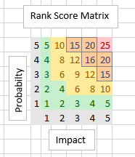
Plan for Risk Management
To manage the risk in our project we will be quantifying them via the risk register and ordering it to reflect the top priority from greatest to least. We will get our priority by multiplying the Impact level by the probability. Once we have this we shall plan around the risks that require the most attention or highest priority.

Slide 14
Plan of Managing Risk for Project Lifecycle
Identify risks
Assess risk
Plan risk response
Implement risk response
Monitor and control risks
Close out risks
Notes:
At the beginning you Identify potential risks that have impact on the project via risk analysis, information, and meetings with the team and stakeholders. Next we assess risks that have been identified and determine their probability of occurrence.
After that we plan our risk response or mitigating factors to combat our risks.
Next we move on to implement these risk responses into our project. After that we monitor and control the risk response implementations are effective and continue to mitigate new risks. Lastly we close out the risks that have been fully managed or mitigated.

Slide 15
How we identify project risks?
Brainstorming
Project team members
Stakeholders
Expert consultant
Notes:
We can identify risks by brainstorming and gathering ideas of potential risks with team members, stakeholders, and experts over a meeting. These individuals working on or advising the project will have good insight on their abilities to gauge the project and its risks involved. Stakeholders will add another view point of risks from their side as they depend on the project completion.

Slide 16
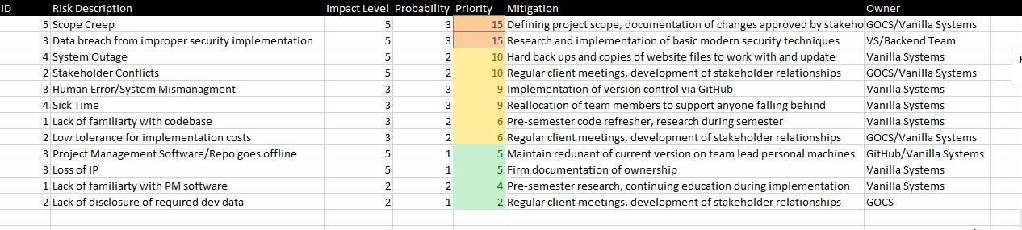
Updated Risk Register
Notes:
Here we can see the updated risk register in order from greatest to least priority.

Slide 17
Keeping the Risk Register Current
Review the risk
Report new risks
Update changes
Communicate changes
Notes:
To keep current with the risk register we will be reviewing the risks involved and their potential impact and updating it accordingly, report new risks to project managers and team members regularly, update the changes with new information regarding new risks, and lastly communicate changes to the stakeholder make sure they are aware and up to date on the risks involved in the project.

Slide 18
Sources
Hayes, A. (2022, December 19). Quality control: What it is, how it works, and QC Careers. Investopedia. Retrieved March 3, 2023, from https://www.investopedia.com/terms/q/quality-control.asp
Project management institute. (2017). A guide to the Project Management Body of Knowledge (Pmbok guide).

